Slide 1
Economic complexity and the wealth of nations Pierre-Alexandre Balland
Notes:
Who I am

Slide 2
Who am I?
French economist specialized in the fields of economic geography, economics of innovation, network science, and applied artificial intelligence

Slide 3
Who am I?
French economist specialized in the fields of economic geography, economics of innovation, network science, and applied artificial intelligence
Professor at Utrecht University and previously held positions at MIT, UCLA and Lund

Slide 4
Who am I?
French economist specialized in the fields of economic geography, economics of innovation, network science, and applied artificial intelligence
Professor at Utrecht University and previously held positions at MIT, UCLA and Lund
Research fellow at the Center for Complex Systems Studies

Slide 5
Who am I?
French economist specialized in the fields of economic geography, economics of innovation, network science, and applied artificial intelligence
Professor at Utrecht University and previously held positions at MIT, UCLA and Lund
Research fellow at the Center for Complex Systems Studies
Expert for the European Commission on innovation policy

Slide 6
Who am I?
French economist specialized in the fields of economic geography, economics of innovation, network science, and applied artificial intelligence
Professor at Utrecht University and previously held positions at MIT, UCLA and Lund
Research fellow at the Center for Complex Systems Studies
Expert for the European Commission on innovation policy
Entrepreneur: data science solutions for business problems

Slide 7
Contact
Website:
https://www.paballand.com
Google Scholar profile:
https://scholar.google.com/citations?user=ORZg_McAAAAJ
Twitter:
https://twitter.com/pa_balland

Slide 8
Economic complexity
Economic development from a complex systems perspective

Slide 9
Economic complexity
Economic development from a complex systems perspective
As the economy becomes more complex, it grows

Slide 10
Economic complexity
Economic development from a complex systems perspective
As the economy becomes more complex, it grows
New technologies and globalization allow for a deeper division of knowledge

Slide 11
Economic complexity
Economic development from a complex systems perspective
As the economy becomes more complex, it grows
New technologies and globalization allow for a deeper division of knowledge
Trade and division of labor and this is a very efficient way to organize the economy

Slide 12
Yes, but!
Increasing complexity creates an overload of information and noise

Slide 13
Yes, but!
Increasing complexity creates an overload of information and noise
This division of knowledge also creates room for hierarchy and inequality

Slide 14
Yes, but!
Increasing complexity creates an overload of information and noise
This division of knowledge also creates room for hierarchy and inequality
Complexity makes key resources very, very concentrated (hello network effects)

Slide 15
Yes, but!
Increasing complexity creates an overload of information and noise
This division of knowledge also creates room for hierarchy and inequality
Complexity makes key resources very, very concentrated (hello network effects)
Increased interdependencies make us more vulnerable to pandemics such as Covid-19, financial, and ecological crises

Slide 16
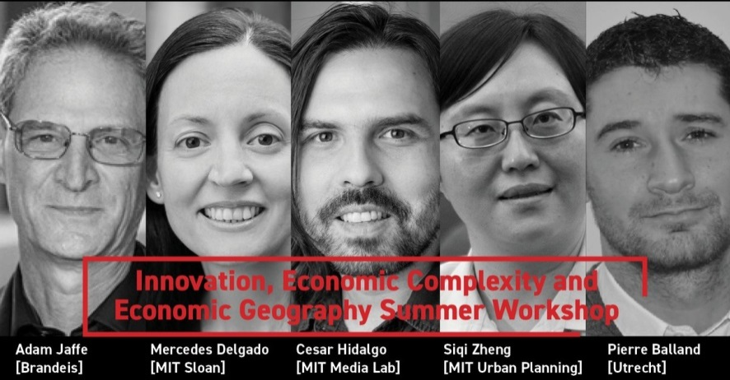
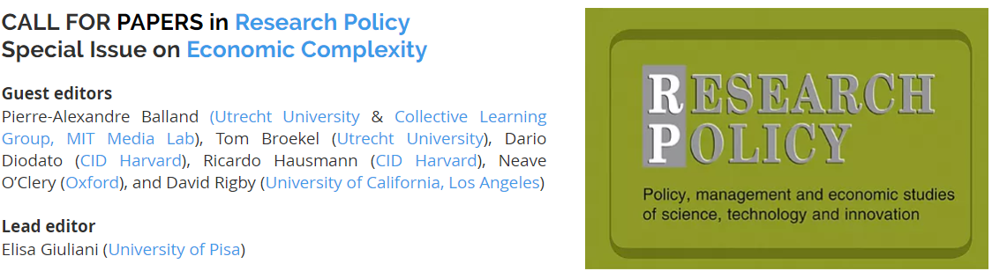


Slide 17
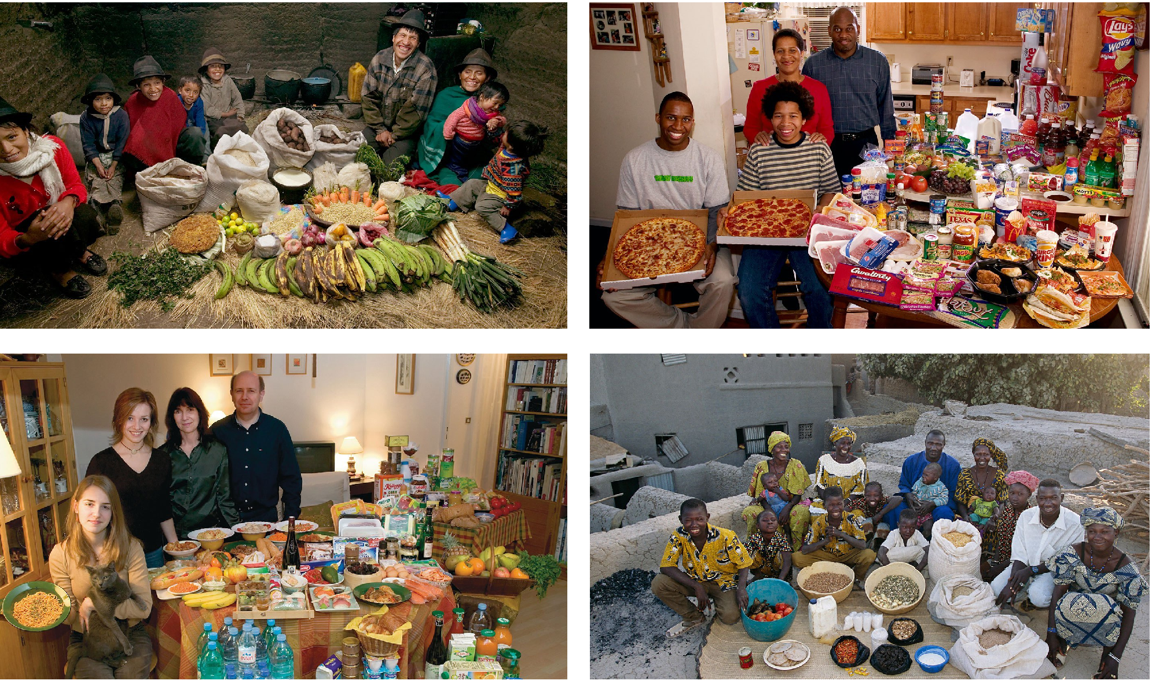
Reframing economic development
Ecuador - $8.17/day | 3.82% < Pov. (PovcalNet)
USA – $48.19/day | 1.00% < Pov. (PovcalNet)
France– $43.17/day | : 0.08% < Pov. (PovcalNet)
Mali – $1.92/day | 49.25% < Pov. (PovcalNet)
Data Source: PovcalNet - World Bank
Menzel, P. and D’Aluisio F. (2005) Hungry Planet: What the World Eats
Notes:
Data is from the PovcalNet database from the World Bank
International poverty line by the world bank: 1.9 $ PPP (Purchasing Power Parity)
<pov: % of population living in households with consumption or income per person below the poverty line ($1.9/day)
"Median$" is the median of daily per capita income/consumption expenditure from the survey in 2011 PPP.
Given monthly in Povcalnet but I multiplied by 12 and divided by 365 to get it daily
> 248.505*12/365
[1] 8.170027
> 1313.09*12/365
[1] 43.17008
> 58.5022*12/365
[1] 1.92336
> 1465.7*12/365
[1] 48.1874

Slide 18
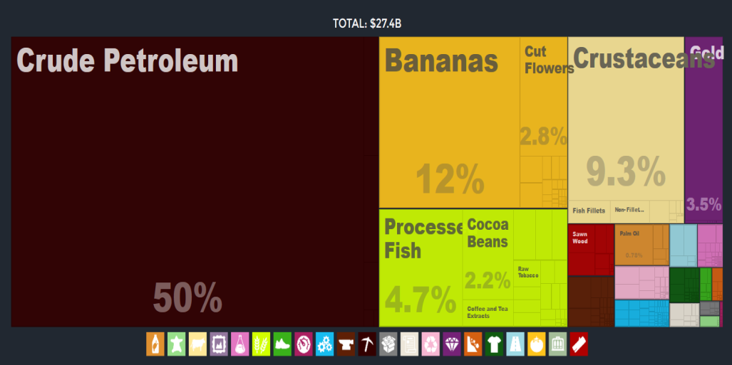
Reframing economic development
USA – $48.19/day | 1.00% < Pov. (PovcalNet)
France– $43.17/day | : 0.08% < Pov. (PovcalNet)
Mali – $1.92/day | 49.25% < Pov. (PovcalNet)
Data Source: atlas.media.mit.edu
Menzel, P. and D’Aluisio F. (2005) Hungry Planet: What the World Eats
Notes:
Data is from the PovcalNet database from the World Bank
International poverty line by the world bank: 1.9 $ PPP (Purchasing Power Parity)
<pov: % of population living in households with consumption or income per person below the poverty line ($1.9/day)
"Median$" is the median of daily per capita income/consumption expenditure from the survey in 2011 PPP.
Given monthly in Povcalnet but I multiplied by 12 and divided by 365 to get it daily
> 248.505*12/365
[1] 8.170027
> 1313.09*12/365
[1] 43.17008
> 58.5022*12/365
[1] 1.92336
> 1465.7*12/365
[1] 48.1874

Slide 19
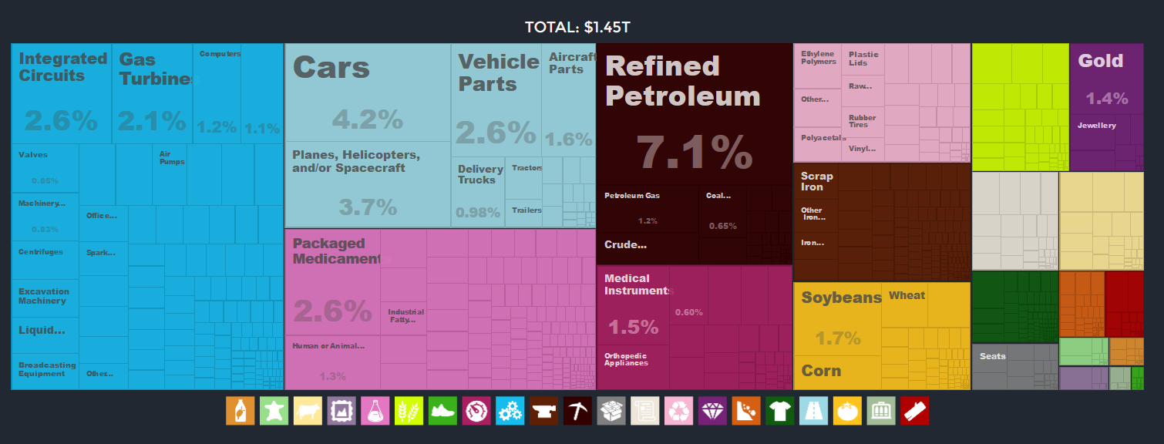
Reframing economic development
USA – $48.19/day | 1.00% < Pov.
France– $43.17/day | : 0.08% < Pov. (PovcalNet)
Mali – $1.92/day | 49.25% < Pov. (PovcalNet)
Data Source: atlas.media.mit.edu
Menzel, P. and D’Aluisio F. (2005) Hungry Planet: What the World Eats
Notes:
Data is from the PovcalNet database from the World Bank
International poverty line by the world bank: 1.9 $ PPP (Purchasing Power Parity)
<pov: % of population living in households with consumption or income per person below the poverty line ($1.9/day)
"Median$" is the median of daily per capita income/consumption expenditure from the survey in 2011 PPP.
Given monthly in Povcalnet but I multiplied by 12 and divided by 365 to get it daily
> 248.505*12/365
[1] 8.170027
> 1313.09*12/365
[1] 43.17008
> 58.5022*12/365
[1] 1.92336
> 1465.7*12/365
[1] 48.1874

Slide 20
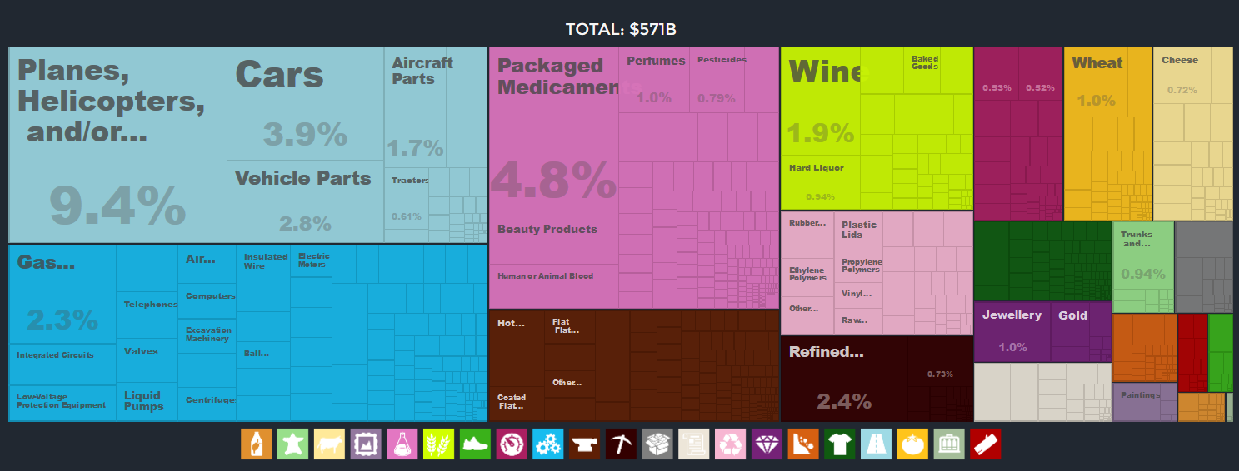
Reframing economic development
USA – $48.19/day | 1.00% < Pov.
France– $43.17/day | : 0.08% < Pov.
Mali – $1.92/day | 49.25% < Pov. (PovcalNet)
Data Source: atlas.media.mit.edu
Menzel, P. and D’Aluisio F. (2005) Hungry Planet: What the World Eats
Notes:
Data is from the PovcalNet database from the World Bank
International poverty line by the world bank: 1.9 $ PPP (Purchasing Power Parity)
<pov: % of population living in households with consumption or income per person below the poverty line ($1.9/day)
"Median$" is the median of daily per capita income/consumption expenditure from the survey in 2011 PPP.
Given monthly in Povcalnet but I multiplied by 12 and divided by 365 to get it daily
> 248.505*12/365
[1] 8.170027
> 1313.09*12/365
[1] 43.17008
> 58.5022*12/365
[1] 1.92336
> 1465.7*12/365
[1] 48.1874

Slide 21
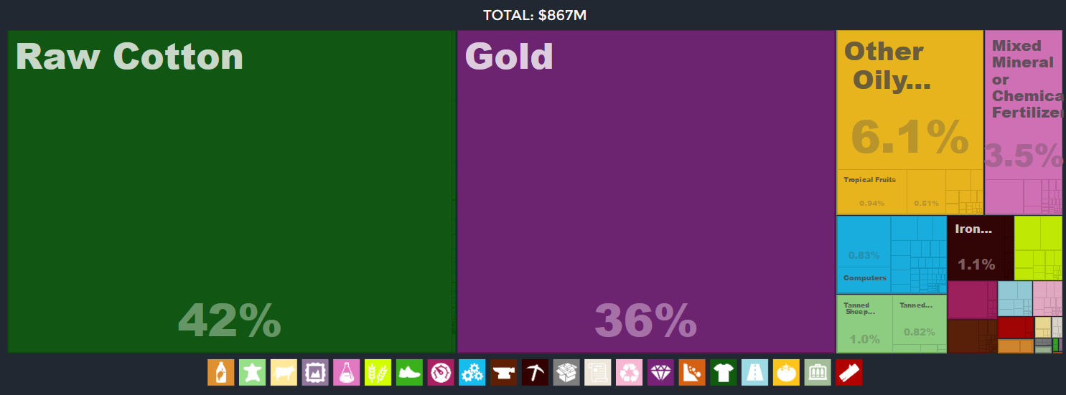
Reframing economic development
USA – $48.19/day | 1.00% < Pov.
France– $43.17/day | : 0.08% < Pov.
Mali – $1.92/day | 49.25% < Pov.
Data Source: atlas.media.mit.edu
Menzel, P. and D’Aluisio F. (2005) Hungry Planet: What the World Eats
Notes:
Path to properity, really about understanding how to move from there to there
Data is from the PovcalNet database from the World Bank
International poverty line by the world bank: 1.9 $ PPP (Purchasing Power Parity)
<pov: % of population living in households with consumption or income per person below the poverty line ($1.9/day)
"Median$" is the median of daily per capita income/consumption expenditure from the survey in 2011 PPP.
Given monthly in Povcalnet but I multiplied by 12 and divided by 365 to get it daily
> 248.505*12/365
[1] 8.170027
> 1313.09*12/365
[1] 43.17008
> 58.5022*12/365
[1] 1.92336
> 1465.7*12/365
[1] 48.1874

Slide 22
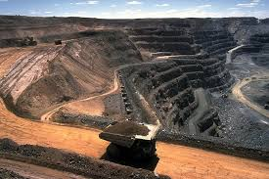


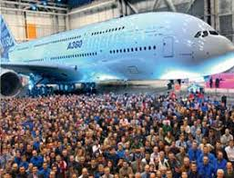
Reframing economic development
USA – $48.19/day | 1.00% < Pov.
France– $43.17/day | : 0.08% < Pov.
Mali – $1.92/day | 49.25% < Pov.
Data Source: atlas.media.mit.edu
Menzel, P. and D’Aluisio F. (2005) Hungry Planet: What the World Eats
Notes:
Path to properity, really about understanding how to move from there to there
Data is from the PovcalNet database from the World Bank
International poverty line by the world bank: 1.9 $ PPP (Purchasing Power Parity)
<pov: % of population living in households with consumption or income per person below the poverty line ($1.9/day)
"Median$" is the median of daily per capita income/consumption expenditure from the survey in 2011 PPP.
Given monthly in Povcalnet but I multiplied by 12 and divided by 365 to get it daily
> 248.505*12/365
[1] 8.170027
> 1313.09*12/365
[1] 43.17008
> 58.5022*12/365
[1] 1.92336
> 1465.7*12/365
[1] 48.1874

Slide 23
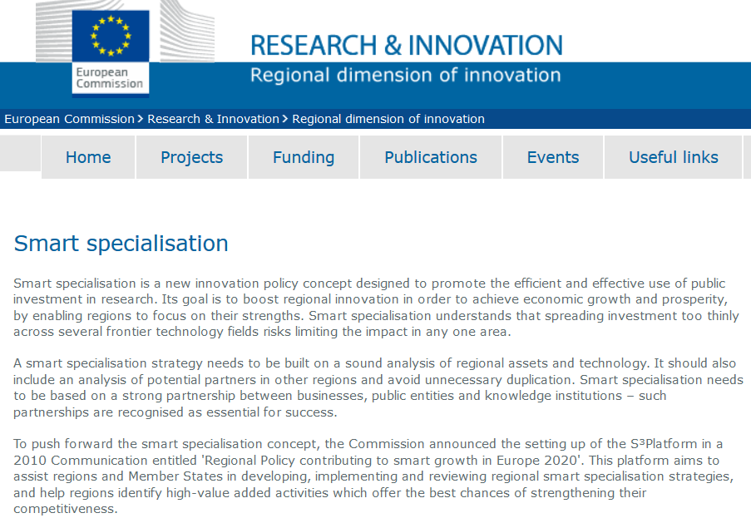
On smart specialization

Slide 24
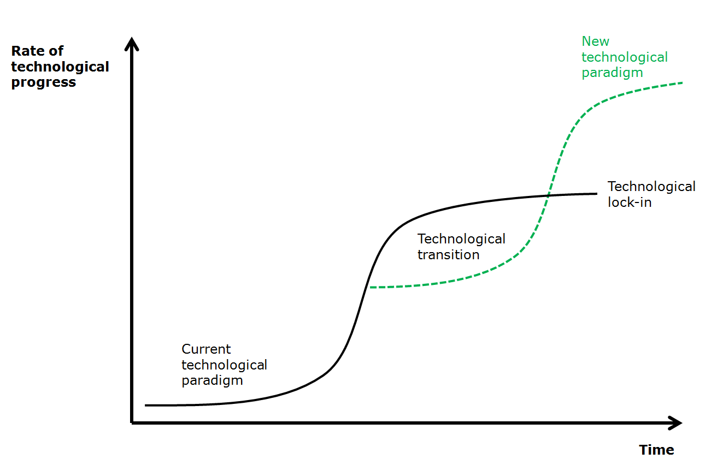

Slide 25
Policy support

Slide 26
Smart Specialization Strategy
Complexity
High Risks
High Benefits
Low Risks
High Benefits
High Risks
Low Benefits
Low Risks
Low Benefits
Relatedness
Balland et al. (2019)

Slide 27
Q&A

